Slide 1
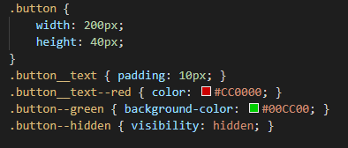
BEM
Block – Element – Modifier
Divide layout into blocks
Blocks contain elements
Define state of block or element with modifiers
Naming convention: block__element--modifier

Slide 2
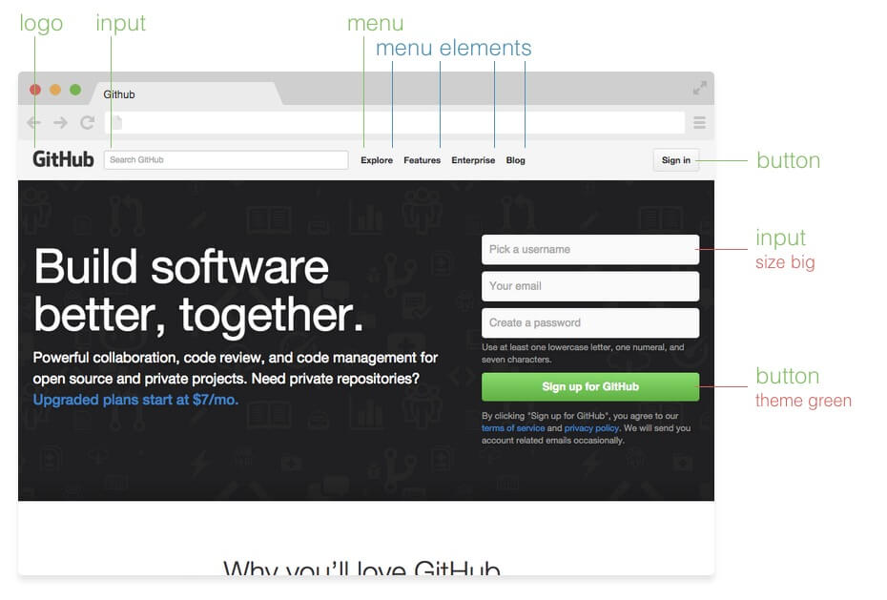
Source: http://getbem.com/introduction/

Slide 3
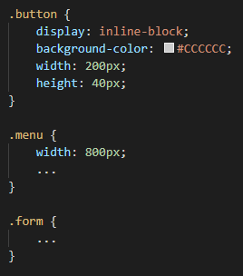
Block
Independent components
Reusable
Defines the purpose

Slide 4
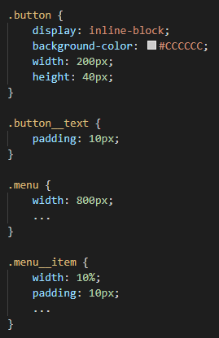
Element
Child of a block
No meaning on its own
Never related to another element
Double underscore as prefix

Slide 5
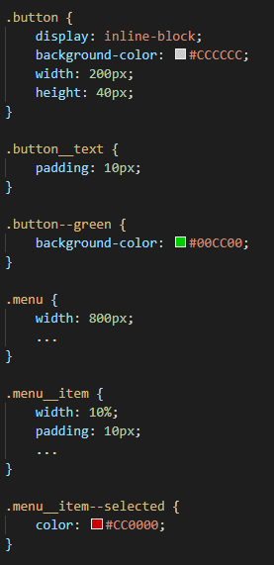

Modifier
Defines state or appearance
Prefix: double hyphen
Modifying element based on block-level modifier is allowed:

Slide 6
Pros & Cons
Easy to use
Reusable styles
Bloated HTML
Components cannot share styles

Slide 7
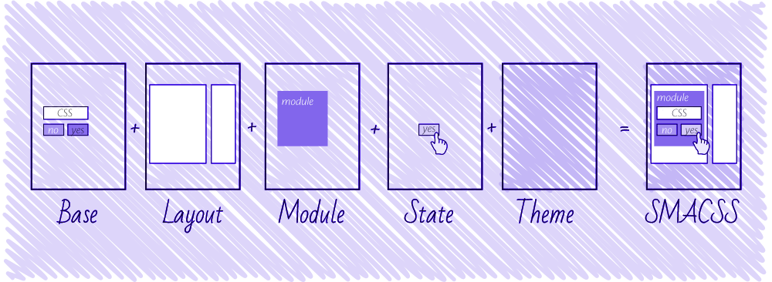
SMACSS
Scalable and Modular Architecture for CSS
CSS rules categorization
5 style categories:
Base
Layout
Module
State
Theme
Source: https://css-tricks.com/methods-organize-css/

Slide 8
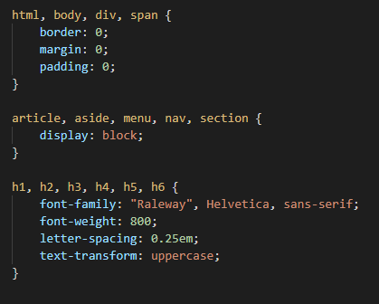
Base Rules
Defaults
Element selector
Example: html, body, form, a

Slide 9
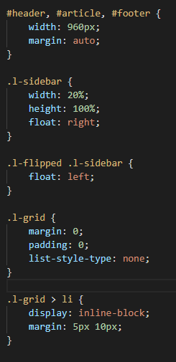
Layout Rules
Defines page sections
Major components
Example: #header, #footer, #sidebar
Combinable with other layout styles
.l- prefix

Slide 10
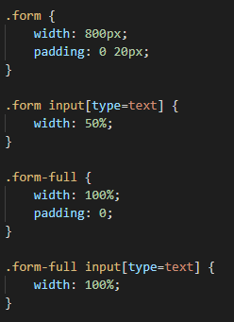
Module Rules
Smaller components
Independent
Reusable
Inside layout components
Related elements: Use module name as prefix
Sub-class modules if necessary

Slide 11
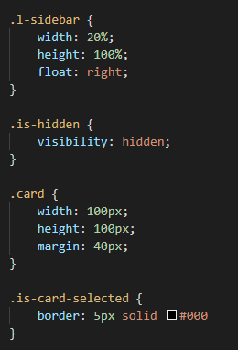
State
Defines current status of element
Applied to layout or module
Overrides other styles
Include module name if it specifically relates to the behavior of a module

Slide 12
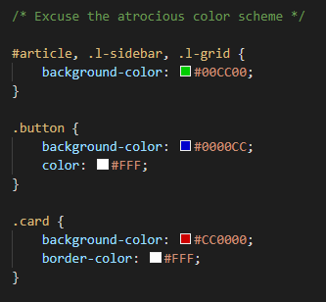
Theme
Replaceable styles
Typically defines the overall look
Can override all other style rules
Not mandatory

Slide 13
Pros & Cons
Organized CSS
Reusable modules
Complicated
Specificity issues

